Slide 1
Lecture 7 – Parallel Computation Patterns (Histogram)
CSD2170 Programming Massively Parallel Processors
Lecture 7.1 - Histogramming

Slide 2
Objective
To learn the parallel histogram computation pattern
An important, useful computation
Very different from all the patterns we have covered so far in terms of output behavior of each thread
A good starting point for understanding output interference in parallel computation
2

Slide 3
Histogram
A method for extracting notable features and patterns from large data sets
Feature extraction for object recognition in images
Fraud detection in credit card transactions
Correlating heavenly object movements in astrophysics
…
Basic histograms - for each element in the data set, use the value to identify a “bin counter” to increment

Slide 4
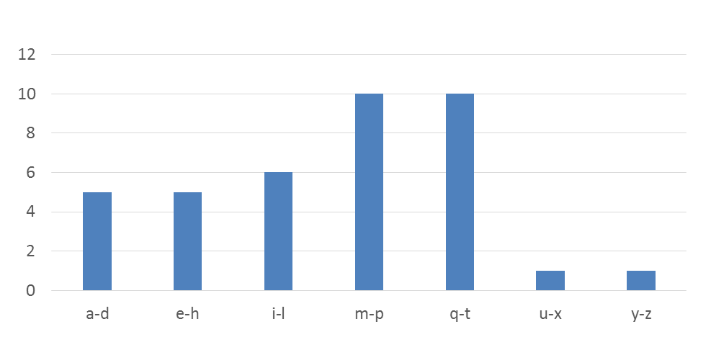
A Text Histogram Example
Define the bins as four-letter sections of the alphabet: a-d, e-h, i-l, n-p, …
For each character in an input string, increment the appropriate bin counter.
In the phrase “Programming Massively Parallel Processors” the output histogram is shown below:

Slide 5
A simple parallel histogram algorithm
Partition the input into sections
Have each thread to take a section of the input
Each thread iterates through its section.
For each letter, increment the appropriate bin counter

Slide 6
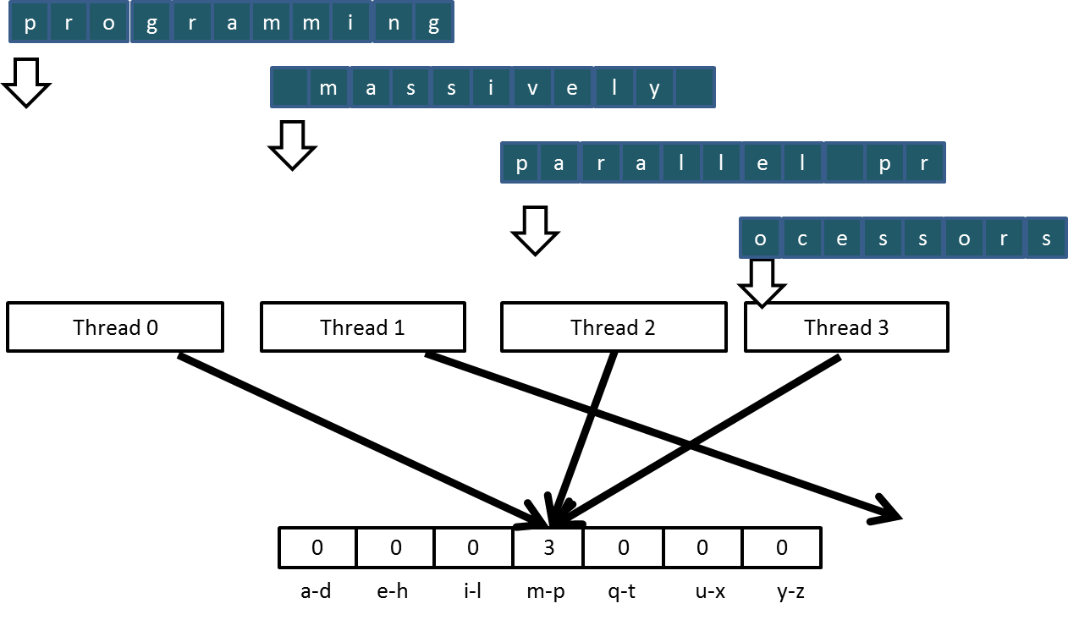
Sectioned Partitioning (Iteration #1)

Slide 7
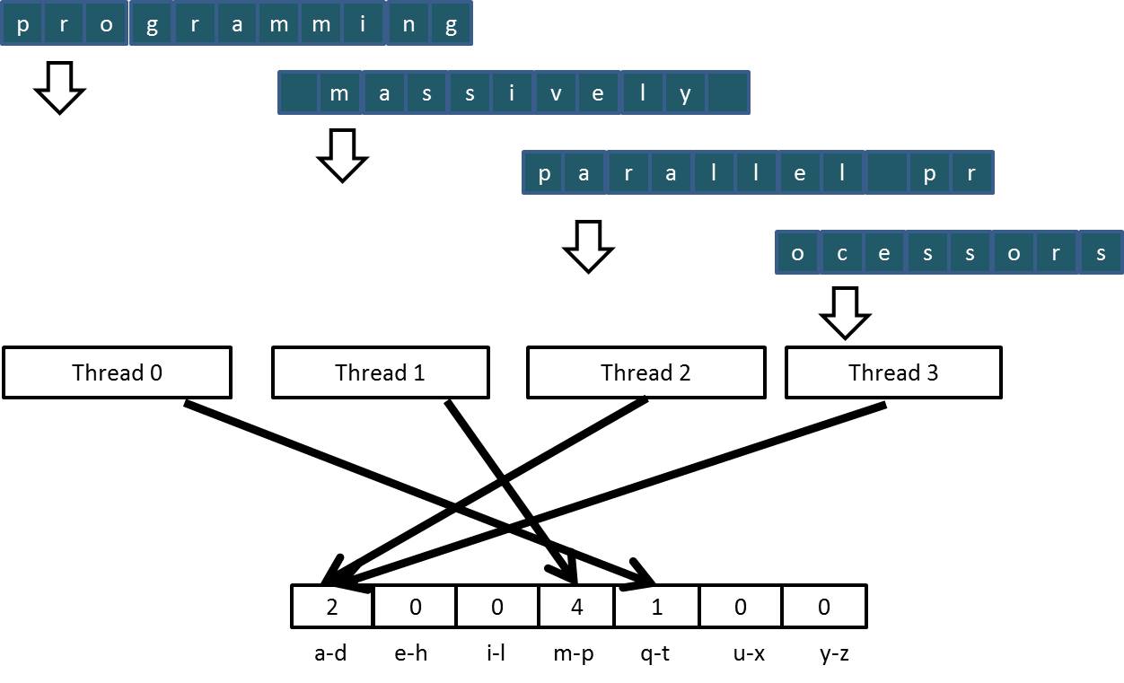
Sectioned Partitioning (Iteration #2)

Slide 8
Input Partitioning Affects Memory Access Efficiency
Sectioned partitioning results in poor memory access efficiency
Adjacent threads do not access adjacent memory locations
Accesses are not coalesced
DRAM bandwidth is poorly utilized

Slide 9
Input Partitioning Affects Memory Access Efficiency
Sectioned partitioning results in poor memory access efficiency
Adjacent threads do not access adjacent memory locations
Accesses are not coalesced
DRAM bandwidth is poorly utilized
Change to interleaved partitioning
All threads process a contiguous section of elements
They all move to the next section and repeat
The memory accesses are coalesced
1
1
1
1
1
2
2
2
2
2
3
3
3
3
3
4
4
4
4
4
1
2
3
4
1
2
3
4
1
2
3
4
1
2
3
4
1
2
3
4

Slide 10
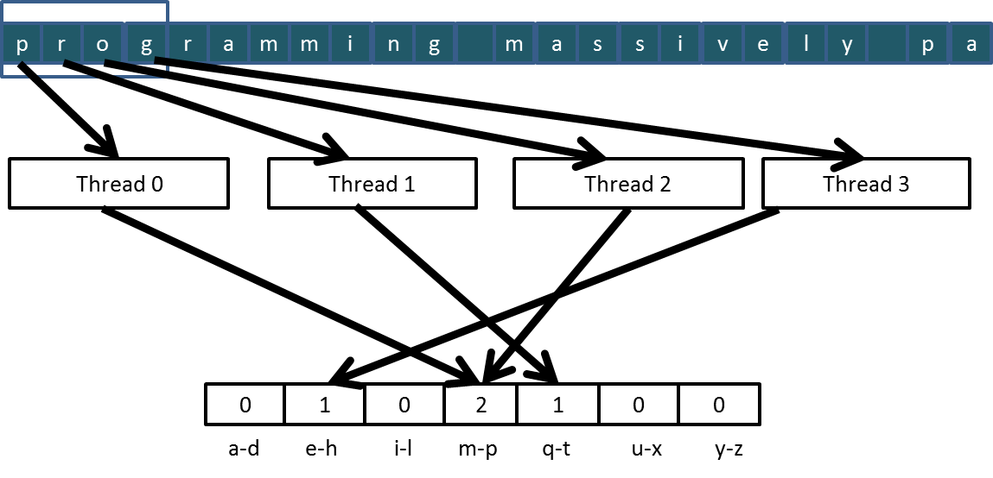
Interleaved Partitioning of Input
For coalescing and better memory access performance
…

Slide 11
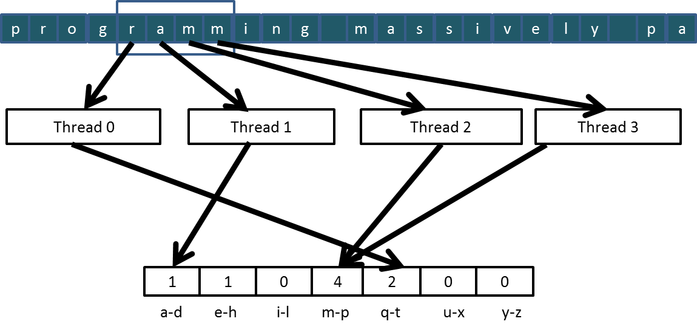
Interleaved Partitioning (Iteration 2)
…

Slide 12
Lecture 7 – Parallel Computation Patterns (Histogram)
CSD2170 Programming Massively Parallel Processors
Lecture 7.2 - Introduction to Data Races

Slide 13
Objective
To understand data races in parallel computing
Data races can occur when performing read-modify-write operations
Data races can cause errors that are hard to reproduce
Atomic operations are designed to eliminate such data races

Slide 14
Read-modify-write in the Text Histogram Example
For coalescing and better memory access performance
…

Slide 15
Read-Modify-Write Used in Collaboration Patterns
For example, multiple bank tellers count the total amount of cash in the safe
Each grab a pile and count
Have a central display of the running total
Whenever someone finishes counting a pile, read the current running total (read) and add the subtotal of the pile to the running total (modify-write)
A bad outcome
Some of the piles were not accounted for in the final total

Slide 16
A Common Parallel Service Pattern
For example, multiple customer service agents serving waiting customers
The system maintains two numbers,
the number to be given to the next incoming customer (I)
the number for the customer to be served next (S)
The system gives each incoming customer a number (read I) and increments the number to be given to the next customer by 1 (modify-write I)
A central display shows the number for the customer to be served next
When an agent becomes available, he/she calls the number (read S) and increments the display number by 1 (modify-write S)
Bad outcomes
Multiple customers receive the same number, only one of them receives service
Multiple agents serve the same number

Slide 17
A Common Arbitration Pattern
For example, multiple customers booking airline tickets in parallel
Each
Brings up a flight seat map (read)
Decides on a seat
Updates the seat map and marks the selected seat as taken (modify-write)
A bad outcome
Multiple passengers ended up booking the same seat

Slide 18
Data Race in Parallel Thread Execution
thread1:
Old ← Mem[x]
New ← Old + 1
Mem[x] ← New
thread2:
Old ← Mem[x]
New ← Old + 1
Mem[x] ← New
Old and New are per-thread register variables.
Question 1: If Mem[x] was initially 0, what would the value of Mem[x] be after threads 1 and 2 have completed?
Question 2: What does each thread get in their Old variable?
Unfortunately, the answers may vary according to the relative execution timing between the two threads, which is referred to as a data race.

Slide 19
Timing Scenario #1
Time | Thread 1 | Thread 2
1 | (0) Old ← Mem[x]
2 | (1) New ← Old + 1
3 | (1) Mem[x] ← New
4 |  | (1) Old ← Mem[x]
5 |  | (2) New ← Old + 1
6 |  | (2) Mem[x] ← New
Thread 1 Old = 0
Thread 2 Old = 1
Mem[x] = 2 after the sequence

Slide 20
Timing Scenario #2
Time | Thread 1 | Thread 2
1 |  | (0) Old ← Mem[x]
2 |  | (1) New ← Old + 1
3 |  | (1) Mem[x] ← New
4 | (1) Old ← Mem[x]
5 | (2) New ← Old + 1
6 | (2) Mem[x] ← New
Thread 1 Old = 1
Thread 2 Old = 0
Mem[x] = 2 after the sequence

Slide 21
Timing Scenario #3
Time | Thread 1 | Thread 2
1 | (0) Old ← Mem[x]
2 | (1) New ← Old + 1
3 |  | (0) Old ← Mem[x]
4 | (1) Mem[x] ← New
5 |  | (1) New ← Old + 1
6 |  | (1) Mem[x] ← New
Thread 1 Old = 0
Thread 2 Old = 0
Mem[x] = 1 after the sequence

Slide 22
Timing Scenario #4
Time | Thread 1 | Thread 2
1 |  | (0) Old ← Mem[x]
2 |  | (1) New ← Old + 1
3 | (0) Old ← Mem[x]
4 |  | (1) Mem[x] ← New
5 | (1) New ← Old + 1
6 | (1) Mem[x] ← New
Thread 1 Old = 0
Thread 2 Old = 0
Mem[x] = 1 after the sequence

Slide 23
Purpose of Atomic Operations – To Ensure Good Outcomes
thread1:
Old ← Mem[x]
New ← Old + 1
Mem[x] ← New
thread2:
Old ← Mem[x]
New ← Old + 1
Mem[x] ← New
Or
thread2:
Old ← Mem[x]
New ← Old + 1
Mem[x] ← New
thread1:
Old ← Mem[x]
New ← Old + 1
Mem[x] ← New

Slide 24
Lecture 7 – Parallel Computation Patterns (Histogram)
CSD2170 Programming Massively Parallel Processors
Lecture 7.3 - Atomic Operations in CUDA

Slide 25
Objective
To learn to use atomic operations in parallel programming
Atomic operation concepts
Types of atomic operations in CUDA
Intrinsic functions
A basic histogram kernel

Slide 26
Data Race Without Atomic Operations
Both threads receive 0 in Old
Mem[x] becomes 1
Mem[x] initialized to 0
thread1:
Old ← Mem[x]
New ← Old + 1
Mem[x] ← New
thread2:
Old ← Mem[x]
New ← Old + 1
Mem[x] ← New
time

Slide 27
Key Concepts of Atomic Operations
A read-modify-write operation performed by a single hardware instruction on a memory location address
Read the old value, calculate a new value, and write the new value to the location
The hardware ensures that no other threads can perform another read-modify-write operation on the same location until the current atomic operation is complete
Any other threads that attempt to perform an atomic operation on the same location will typically be held in a queue
All threads perform their atomic operations serially on the same location

Slide 28
Atomic Operations in CUDA
Performed by calling functions that are translated into single instructions (a.k.a. intrinsic functions or intrinsics)
Atomic add, sub, inc, dec, min, max, exch (exchange), CAS (compare and swap)
Read CUDA C programming Guide 4.0 or later for details
Atomic Add
int atomicAdd(int* address, int val);
reads the 32-bit word old from the location pointed to by address in global or shared memory, computes (old + val), and stores the result back to memory at the same address. The function returns old.

Slide 29
More Atomic Adds in CUDA
Unsigned 32-bit integer atomic add
unsigned int atomicAdd(unsigned int* address,
unsigned int val);
Unsigned 64-bit integer atomic add
unsigned long long int atomicAdd(unsigned long long
int* address, unsigned long long int val);
Single-precision floating-point atomic add (capability > 2.0)
float atomicAdd(float* address, float val);

Slide 30
A Basic Text Histogram Kernel
The kernel receives a pointer to the input buffer of byte values
Each thread process the input in a strided pattern
__global__ void histo_kernel(unsigned char *buffer,
long size, unsigned int *histo)
{
int i = threadIdx.x + blockIdx.x * blockDim.x;
// stride is total number of threads
int stride = blockDim.x * gridDim.x;
// All threads handle blockDim.x * gridDim.x
// consecutive elements
while (i < size) {
atomicAdd( &(histo[buffer[i]]), 1);
i += stride;
}
}

Slide 31
A Basic Histogram Kernel (cont.)
The kernel receives a pointer to the input buffer of byte values
Each thread process the input in a strided pattern
__global__ void histo_kernel(unsigned char *buffer,
long size, unsigned int *histo)
{
int i = threadIdx.x + blockIdx.x * blockDim.x;
// stride is total number of threads
int stride = blockDim.x * gridDim.x;
// All threads handle blockDim.x * gridDim.x
// consecutive elements
while (i < size) {
int alphabet_position = buffer[i] – “a”;
if (alphabet_position >= 0 && alpha_position < 26)
atomicAdd(&(histo[alphabet_position/4]), 1);
i += stride;
}
}

Slide 32
Lecture 7 – Parallel Computation Patterns (Histogram)
CSD2170 Programming Massively Parallel Processors
Lecture 7.4 - Atomic Operation Performance

Slide 33
Objective
To learn about the main performance considerations of atomic operations
Latency and throughput of atomic operations
Atomic operations on global memory
Atomic operations on shared L2 cache
Atomic operations on shared memory

Slide 34
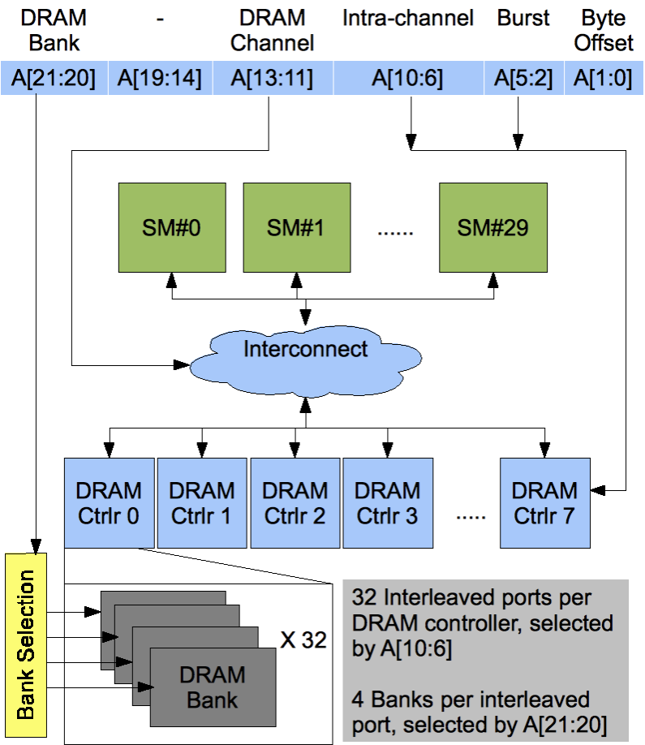
Atomic Operations on Global Memory (DRAM)
An atomic operation on a DRAM location starts with a read, which has a latency of a few hundred cycles
The atomic operation ends with a write to the same location, with a latency of a few hundred cycles
During this whole time, no one else can access the location

Slide 35
Atomic Operations on DRAM
Each Read-Modify-Write has two full memory access delays
All atomic operations on the same variable (DRAM location) are serialized
time
DRAM read latency
DRAM write latency
DRAM read latency
DRAM write latency
atomic operation N
atomic operation N+1

Slide 36
Latency determines throughput
Throughput of atomic operations on the same DRAM location is the rate at which the application can execute an atomic operation.
The rate for atomic operation on a particular location is limited by the total latency of the read-modify-write sequence, typically more than 1000 cycles for global memory (DRAM) locations.
This means that if many threads attempt to do atomic operation on the same location (contention), the memory throughput is reduced to < 1/1000 of the peak bandwidth of one memory channel!

Slide 37
You may have a similar experience in supermarket checkout
Some customers realize that they missed an item after they started to check out
They run to the isle and get the item while the line waits
The rate of checkout is dramatically reduced due to the long latency of running to the isle and back.
Imagine a store where every customer starts the check out before they even fetch any of the items
The rate of the checkout will be 1 / (entire shopping time of each customer)

Slide 38
Hardware Improvements
Atomic operations on Fermi L2 cache
Medium latency, about 1/10 of the DRAM latency
Shared among all blocks
“Free improvement” on Global Memory atomics
time
L2 latency
L2 latency
L2 latency
L2 latency
atomic operation N
atomic operation N+1

Slide 39
Hardware Improvements
Atomic operations on Shared Memory
Very short latency
Private to each thread block
Need algorithm work by programmers (more later)
time
..
atomic operation N
atomic operation N+1

Slide 40
Lecture 7 – Parallel Computation Patterns (Histogram)
CSD2170 Programming Massively Parallel Processors
Lecture 7.5 - Handling Arbitrary Matrix Sizes in Tiled Algorithms

Slide 41
Objective
Learn to write a high performance kernel by privatizing outputs
Privatization as a technique for reducing latency, increasing throughput, and reducing serialization
A high performance privatized histogram kernel
Practical example of using shared memory and L2 cache atomic operations

Slide 42

Privatization
Heavy contention and serialization
Block 0
Block 1
…
Block N
Block 0
Block 1
…
Block N
Copy 0
Copy 1
Copy N
…
Final Copy
Final Copy
Atomic Updates

Slide 43
Privatization (cont.)
Much less contention and serialization
Block 0
Block 1
…
Block N
Block 0
Block 1
…
Block N
Copy 0
Copy 1
Copy N
…
Final Copy
Final Copy
Atomic Updates

Slide 44
Privatization (cont.)
Block 0
Block 1
…
Block N
Block 0
Block 1
…
Block N
Copy 0
Copy 1
Copy N
…
Final Copy
Final Copy
Atomic Updates
Much less contention
and serialization

Slide 45
Cost and Benefit of Privatization
Cost
Overhead for creating and initializing private copies
Overhead for accumulating the contents of private copies into the final copy
Benefit
Much less contention and serialization in accessing both the private copies and the final copy
The overall performance can often be improved more than 10x

Slide 46
Shared Memory Atomics for Histogram
Each subset of threads are in the same block
Much higher throughput than DRAM (100x) or L2 (10x) atomics
Less contention – only threads in the same block can access a shared memory variable
This is a very important use case for shared memory!

Slide 47
Shared Memory Atomics Requires Privatization
Create private copies of the histo[] array for each thread block
__global__ void histo_kernel(unsigned char *buffer,
long size, unsigned int *histo)
{
__shared__ unsigned int histo_private[7];

Slide 48
Shared Memory Atomics Requires Privatization
Create private copies of the histo[] array for each thread block
__global__ void histo_kernel(unsigned char *buffer,
long size, unsigned int *histo)
{
__shared__ unsigned int histo_private[7];
if (threadIdx.x < 7) histo_private[threadidx.x] = 0;
__syncthreads();
Initialize the bin counters in the private copies of histo[]

Slide 49
Build Private Histogram
int i = threadIdx.x + blockIdx.x * blockDim.x;
// stride is total number of threads
int stride = blockDim.x * gridDim.x;
while (i < size) {
atomicAdd( &(private_histo[buffer[i]/4]), 1);
i += stride;
}

Slide 50
Build Final Histogram
// wait for all other threads in the block to finish
__syncthreads();
if (threadIdx.x < 7) {
atomicAdd(&(histo[threadIdx.x]), private_histo[threadIdx.x] );
}
}

Slide 51
More on Privatization
Privatization is a powerful and frequently used technique for parallelizing applications
The operation needs to be associative and commutative
Histogram add operation is associative and commutative
No privatization if the operation does not fit the requirement
The private histogram size needs to be small
Fits into shared memory
What if the histogram is too large to privatize?
Sometimes one can partially privatize an output histogram and use range testing to go to either global memory or shared memory

